Slide 1





ISBM College of Engineering
Department of Computer Engineering
SMART TRIAGE SYSTEM FOR PATIENT ASSIGNMENT AFTER DISASTERS
Presented By : Nishant Rajput, Atharva Gayakwad, Pranav Ikade, Vaibhav Patiil
Project Guide : Prof. C.S. Wagh

Slide 2


Contents
Problem Statement
Introduction
Purpose
Scope
Literature Survey
Domain Introduction
Algorithms Used
System Architecture
Implementation
Software Requirements
Advantages
References
Conclusion

Slide 3
Problem Statement
Ideally, the first people to need medical care receive it.
In less than ideal conditions, somebody has to decide who receives care first. Some health facilities face these decisions on a daily basis, even without any disaster or health emergency.
However, natural disasters (e.g. earthquakes) or other events (e.g. train crash or bombing) can result in a large number of injured or sick people at one time. When this happens, decisions must be made about how to best allocate care when resources are insufficient for all those who need care.
This process is called Triage.

Slide 4


Introduction
The design and implementation of a triage system to automate patient handling and assignment to hospitals in a mass disasters involving a large number of injured victims over a wireless network.
System includes Location aware features at the disaster sites as well as quick classification and assignment of patients to nearby hospitals.
Triage is derived from the French term 'trier' which means to select or choose or classify, and it refers to a system that quickly evaluates the severity of each patient indicates the best treatment depending on his/her condition.

Slide 5
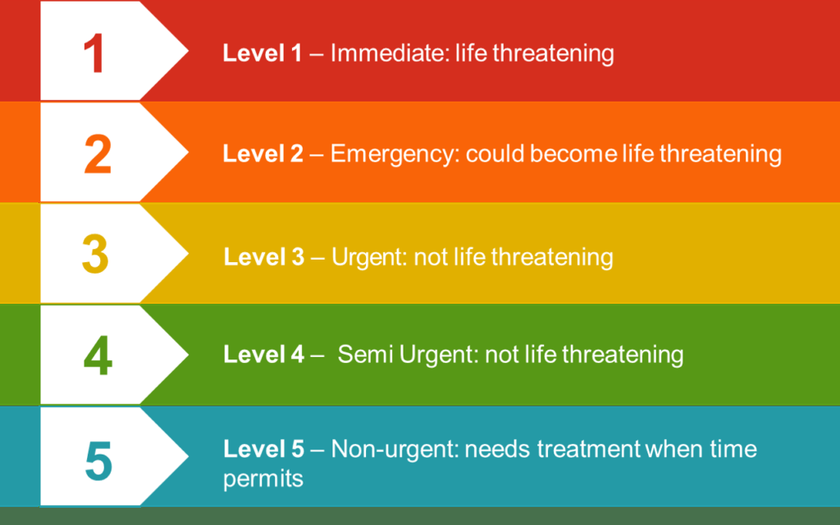

Slide 6

Purpose
The purpose of triage is to save as many lives as possible.
During a severe pandemic, you can expect that the period of time when the need for care will be greater than the resources available will last for weeks or months.
Using scarce medical resources to provide care for patients who may be very sick, but who will probably die even with intensive care, may result in other less sick patients not receiving care, getting sicker, and dying.
When done properly, triage results in the best outcome for the greatest number of people. Without a triage plan in place, resources are likely to be wasted—and more people are likely to die.

Slide 7

Scope
Project will determine the process of determining the priority of patients’ treatments based on the severity of their condition.
This rations patient treatments efficiency when resources are insufficient for all to be treated immediately.
This project deals with the concept of triage as it occurs in medical emergencies, including the
pre-hospital setting , disasters, and emergency department treatment

Slide 8
Literature Survey
Udaya B Kapur and Raghu B Korrapati had proposed system a neural network is used to foretell which of the patients seen in an emergence room need to be admitted, transferred to a speciality care or discharged.
H.A. Chong and K.B. Ganin has proposed a system that acquires vital signs, syndrome and chief complaint from patient.
Triage Systems in Mass Casuality incidents and Disasters: A Review study with a Worldwide approach - Jafar Bazyar, Mehrdad Farrokhi, Hamidreza Khankeh.

Slide 9

Domain Introduction
Machine Learning is the preferred technique of predicting or classifying the information to assist folks in creating necessary selections.
Machine Learning algorithms are trained over instances or examples through that they learn from past experiences and analyze the knowledge.

Slide 10
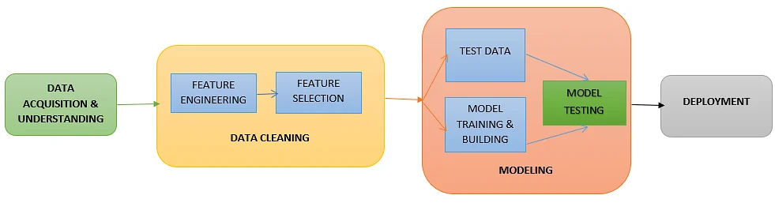
Machine Learning Process:

Slide 11
Algorithms Used :

Slide 12
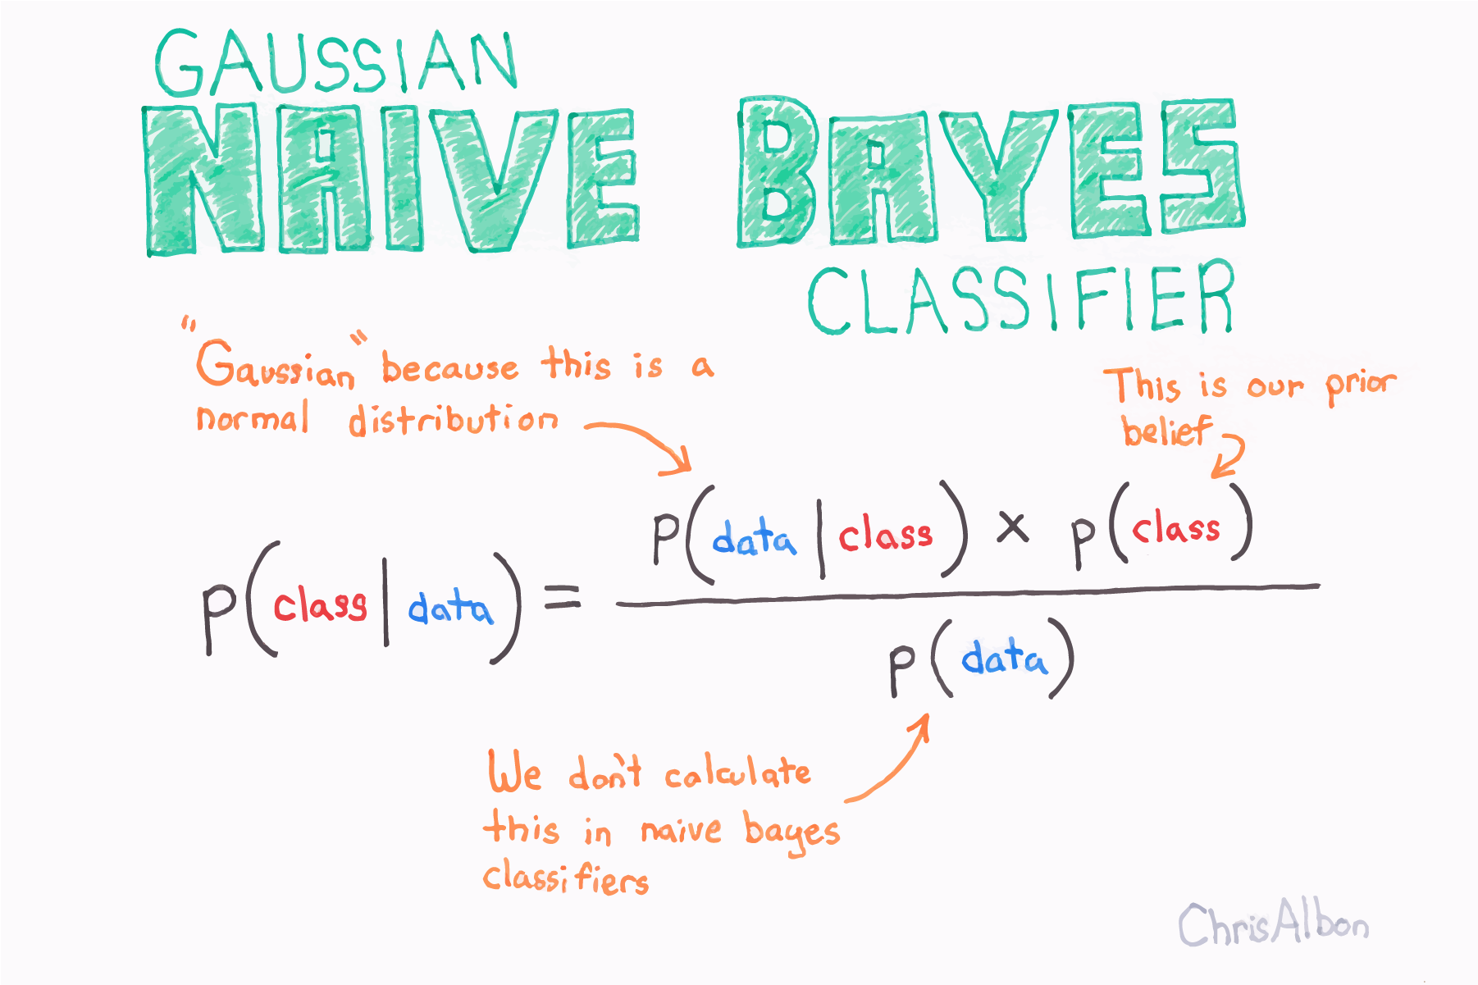
Gaussian Naïve Bayes :
Naïve Bayes is a probabilistic machine learning algorithm used for many classification functions and is based on the Bayes theorem.
Gaussian Naïve Bayes is the extension of naïve Bayes. While other functions are used to estimate data distribution, Gaussian or normal distribution is the simplest to implement as you will need to calculate the mean and standard deviation for the training data.

Slide 13
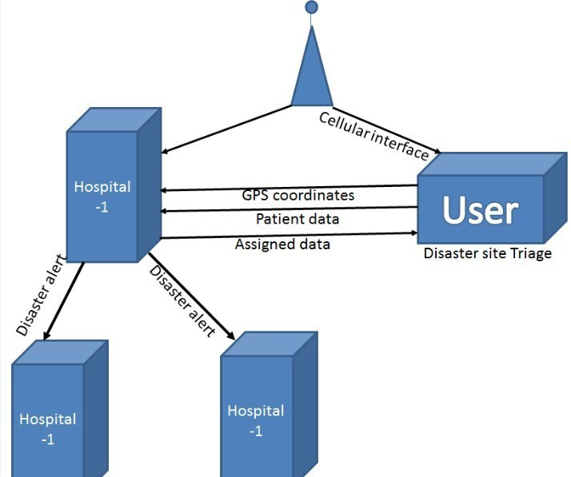
System Architecture

Slide 14
Implementation :

Slide 15
Gathering the dataset and importing it

Slide 16
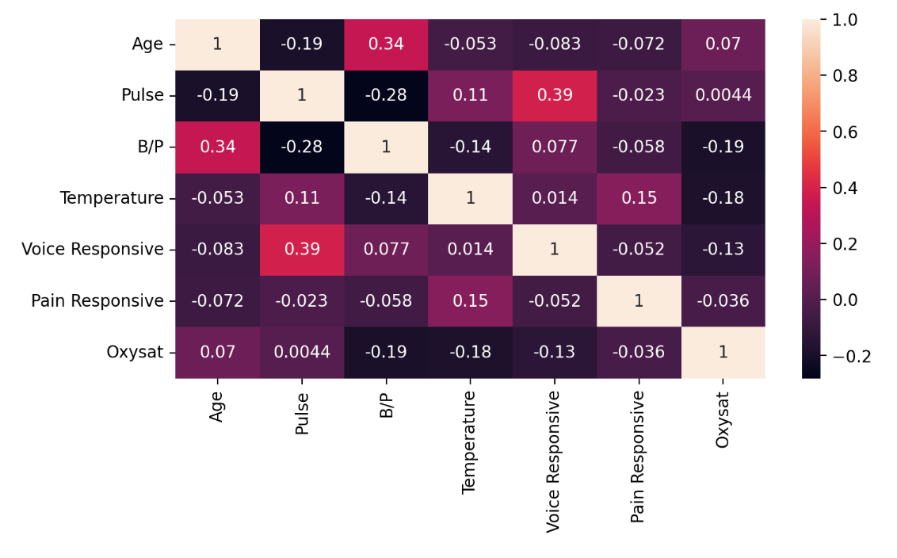
Understanding Co-relation between features of the dataset

Slide 17
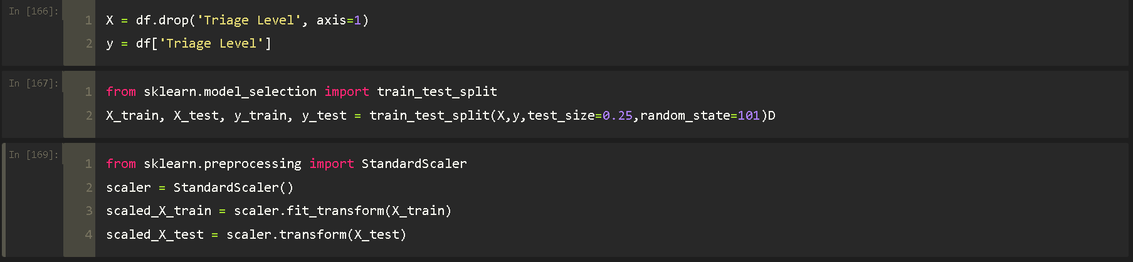
Splitting the data and applying Standardization

Slide 18
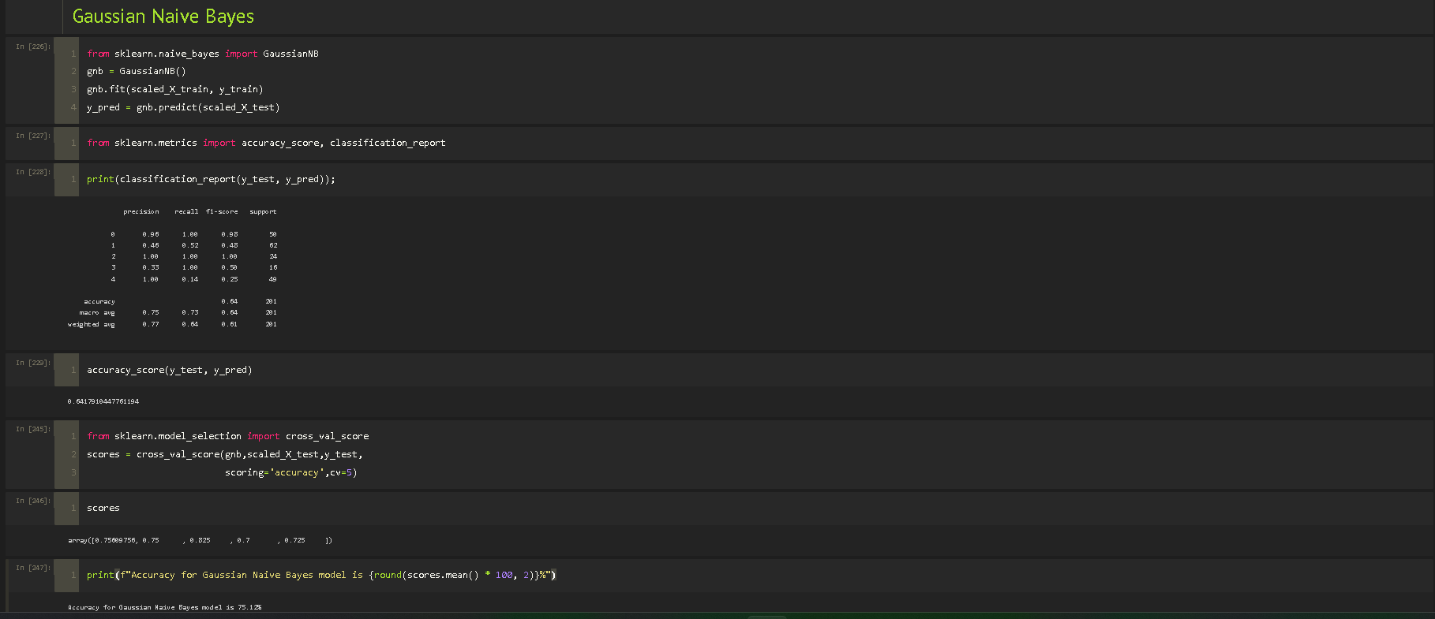
Gaussian Naïve Bayes Model

Slide 19
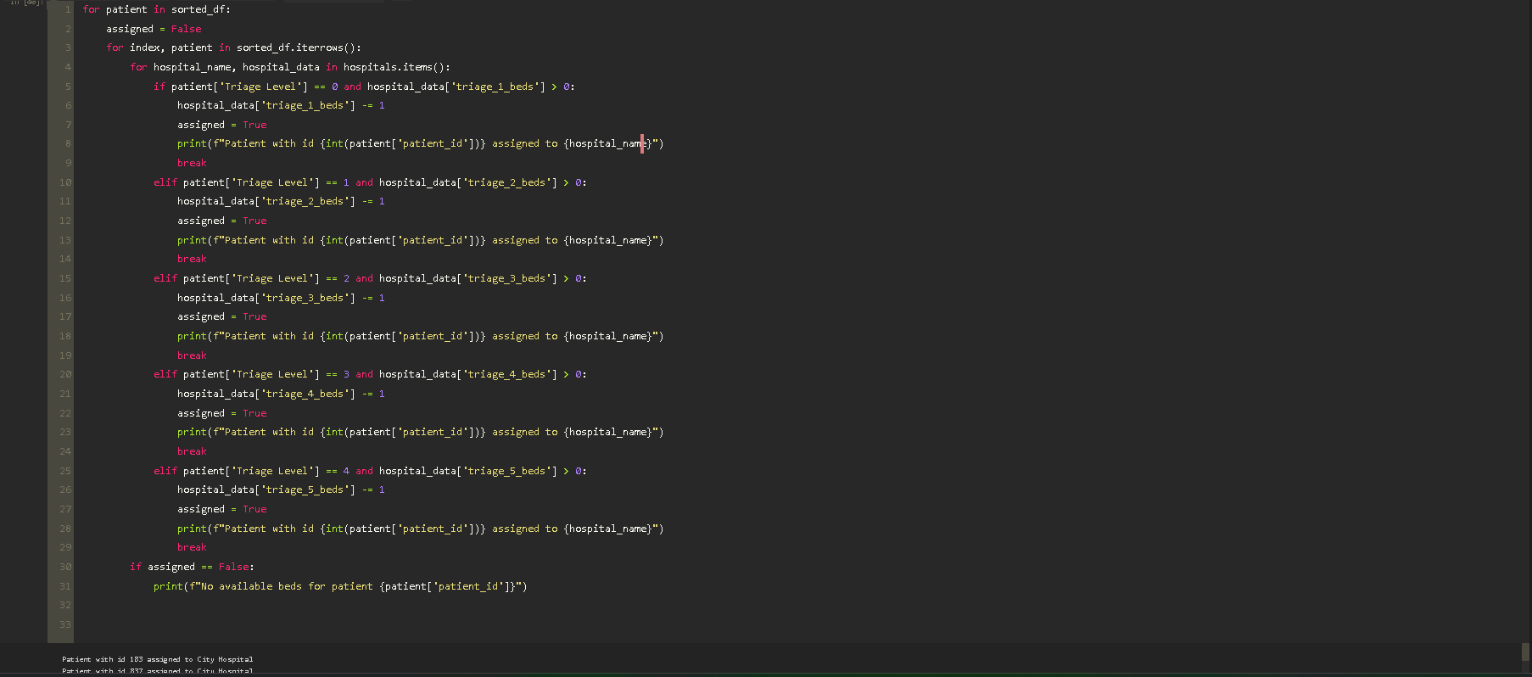
Code that assigns Hospitals to the patients

Slide 20
Software Requirement
Operating System: Windows 7/8/10, Ubuntu
System type : 64bit/32bit OS
For Development -
Tools - Pycharm/Jupyter Postman
Dependencies - Python3
Flask
pip modules
pip version manager
Scikit-Learn
Pandas
Numpy

Slide 21
Advantages
To expedite the delivery of time-critical treatment for patients with life-threatening conditions.
To ensure that ALL people requiring emergency care are appropriately categorized according to their clinical condition.
To improve patient flow.
To improve patient satisfaction.
To decrease the patient's overall length of stay. To facilitate streaming of less urgent patients.
To be user-friendly for all levels of health care professionals .

Slide 22
Conclusion
The results from this study clearly illustrate a lack of correct prioritization of patients in relation to the need for timely assessment.
This is further demonstrated by the retrospective triage classification of patients, which identified patients with high ISS as in urgent need of care.
Since no significant difference into time to assessment regardless of injury severity was observed, the need for a well-functioning triage system is apparent.

Slide 23
References
Byron Graham, Raymond Bond, Michael Quinn and Maurice Mulvenna. “Using Data Mining to Predict Hospital Admissions from the Emergency Department. ” School of Computing and Mathematics, Ulster University, Newtownabbey
Development of Automated Triage System for Emergency Medical Service
H.A. Chong K. B. Gan
3. Triage Systems in Mass Casualty Incidents and Disasters: A Review Study with A Worldwide
Approach Jafar Bazyar, Mehrdad Farrokhi, Hamidreza Khankeh
4. A Wireless First Responder Handheld Device for Rapid Triage, Patient Assessment and
Documentation during Mass Casualty Incidents James P. Killeen, MD1 ; Theodore C. Chan, MD1
Colleen Buono, MD1 ; William G. Griswold, PhD3 ; Leslie A. Lenert, MD MS

Slide 24






Thank You

